Slide 1
Rise of the machines
An ode to Machine Learning
Notes:
Good Morning. Today’s topic of interest is machine learning.

Slide 2
68 YEARS EARLIER...
Notes:
The seed for modern day machine learning was planted 68 years earlier.

Slide 3
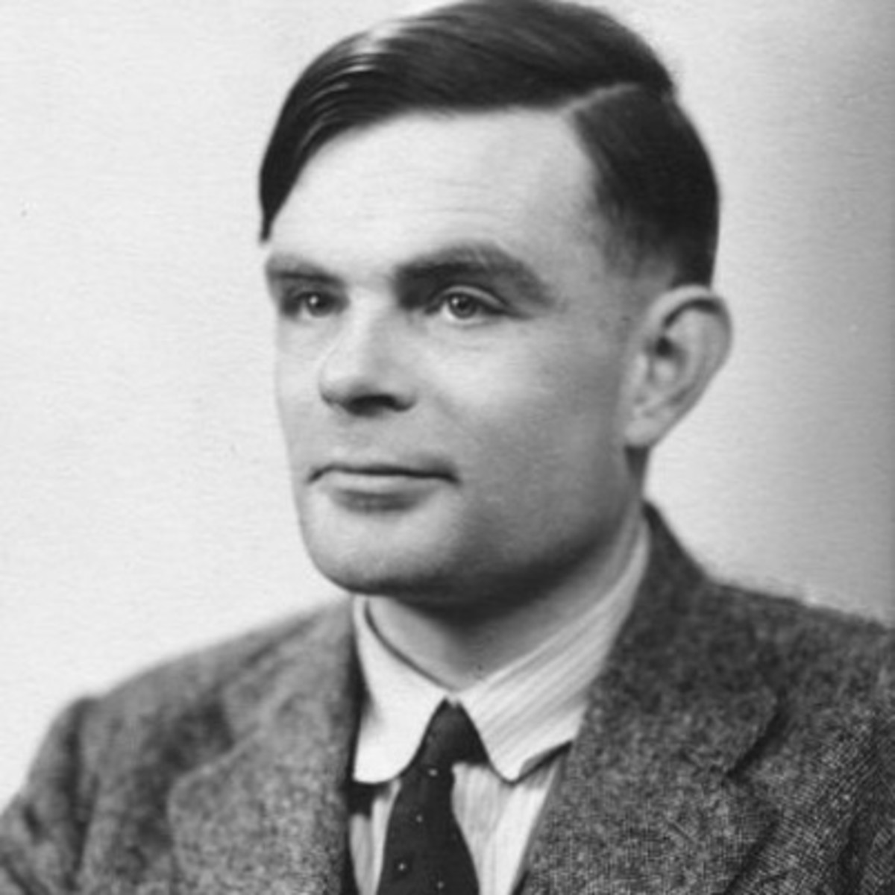
Alan Turing
British Mathematician considered as the father of AI.
Published a paper titled “Computing Machinery and Intelligence” in 1950
Paper suggested that machines could surprise humans where the consequences of different facts were not immediately recognizable.
Devised the Turing test that measured a machine’s ability to exhibit intelligent behavior.

Slide 4
PRESENT DAY...
Notes:
From there, we will fast forward to the present day...

Slide 5

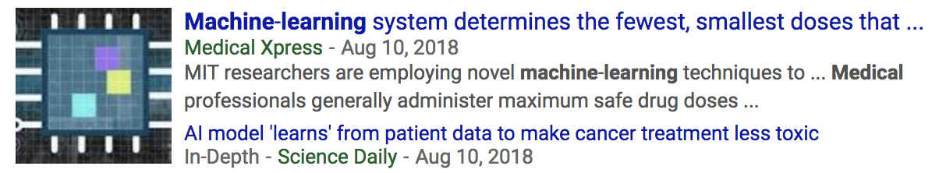

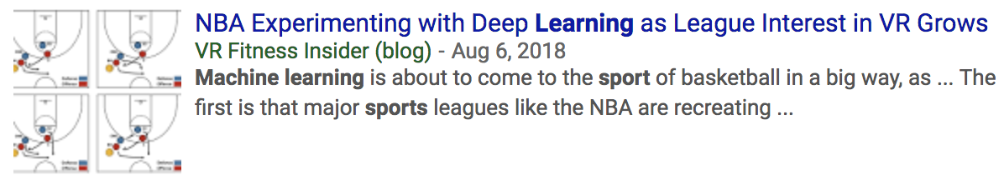

Notes:
...and see that Machine Learning is used in the field of law enforcement, medicine, professional sports, scientific research to name a few.

Slide 6
ONE GOOD REASON
Notes:
What’s the one good reason that would prompt us to use machine learning?

Slide 7
“Machine learning is the science of getting computers to act without being explicitly programmed, but instead letting them learn a few tricks on their own”
Notes:
The ability to continuously learn and improve with data and time makes a compelling reason for its usage.

Slide 8
HELLO MACHINE LEARNING
Notes:
Let’s look at the fundamental steps involved in implementing a machine learning use case.

Slide 9
Load data points
import pandas as pd
df = pd.read_table('smsspamcollection/SMSSpamCollection',
sep='\t',
header=None,
names=['label', 'sms_message'])
df['label'] = df.label.map({'ham':0, 'spam':1})
from sklearn.cross_validation import train_test_split
X_train, X_test, y_train, y_test = train_test_split(
df['sms_message'],
df['label'],
random_state=1
)
count_vector = CountVectorizer()
training_data = count_vector.fit_transform(X_train)
testing_data = count_vector.transform(X_test)
from sklearn.naive_bayes import MultinomialNB
naive_bayes = MultinomialNB()
naive_bayes.fit(training_data, y_train)
predictions = naive_bayes.predict(testing_data)
from sklearn.metrics import accuracy_score, precision_score, recall_score, f1_score
print('Accuracy score: ', format(accuracy_score(y_test, predictions)))
print('Precision score: ', format(precision_score(y_test, predictions)))
print('Recall score: ', format(recall_score(y_test, predictions)))
print('F1 score: ', format(f1_score(y_test, predictions)))
Split into training and test data points
Feature engineer the data points
Train the model
Predict results from the model
Measure the efficacy of the model

Slide 10
MEANS TO AN END
Notes:
Let’s look at the broad categories of machine learning techniques.

Slide 11
Supervised Learning
The model learns a mapping function to derive output variable from input variables
Classification and Regression models fall under this category
The output variable has a discrete label value in classification models
The output variable has a continuous numerical value in regression models
Unsupervised Learning
Output variable is not defined for a given set of input variables
Goal is to understand the distribution in the data
Clustering models discover inherent groupings in the data
Association models discover rule patterns in the data
Reinforcement Learning
Learning agent learns from experience through trial and error
Agent learns to maximize reward via exploration/exploitation tradeoff
Deep Learning
Network composed of several neural layers
Each successive layer unravels more complex features in the data set
Best used to process tons of raw text, pictures, audio and video

Slide 12
MEET YOUR METRIC
Notes:
How do we measure the efficacy of a machine learning model?

Slide 13
+
Actual
-
Accuracy
Measures how often the model makes the right prediction
Precision
Measures the correct number of results over a sum of correct and incorrect results
Recall
Measures the correct number of results over the actual number of results
F1 Score
Measures accuracy by considering precision and recall values
Harmonic mean of precision and recall values
Log Loss
Measures accuracy of a classifier by penalizing false classifications
Minimal log loss indicates better performing model
R² Coefficient of determination
Measures the amount of variance predicted in the dependent variable from independent variables
Used in regression models
Accuracy = (True+ + True-) / # of observations
Precision = (True+) / (True+ + False+)
Recall = (True+) / (True+ + False-)
+
True+ | False+
False- | True-
Predicted
-

Slide 14
THE TOOLBOX
Notes:
There’s plenty of software firepower available to implement machine learning models.

Slide 15













Notes:
These are some of the popular frameworks used in the world of machine learning.

Slide 16
DANCE WITH DATA
Notes:
Data is the most important ingredient in a machine learning model. Let’s look at ways to present data into the model.

Slide 17
One hot encoding
Categorical data with label values is converted to binary values
Scaling
Wide range of raw data values can skew the model’s prediction ability
Scaling helps smooth out the range of values
MinMax scaler rescales data to a range of [0, 1] or [-1, 1]
Standard scaler rescales data with the help of its mean and standard deviation
Bag of words
Used to convert raw unstructured text into a numerical representation
Text is one hot encoded to represent occurrence of word in a document
Term Frequency-Inverse Document Frequency model helps surface rare informational words in a document
Word Vectors
Efficient vector representation of a word given its surrounding context of words
Word2vec is a popular model for word vector representation
Principal Component Analysis
Given a large number of features, PCA helps reduce dimensionality and focus on relevant variables
Measures the magnitude of relationship between variables and drops variables with weaker relationships
Genre | Action | Comedy
Action | 1 | 0
Comedy | 0 | 1

Slide 18
If you liked this presentation, there’s a probability that

Slide 19
Credits
biography.com
Terminator Movie Franchise
GIPHY
Google
gdpulse.com
scikit-learn.org
machinelearningmastery.com
blog.acolyer.org
towardsdatascience.com
medium.com
Stanford
Dr. Danko Nikolic
techemergence.com
Wikipedia
skymind.ai
Notes:
Paying my respects to these wonderful resources that made this presentation happen.

Slide 20
THANK YOU
Notes:
With that, I conclude the presentation. Thank you for giving me this opportunity and I hope that you enjoyed the presentation.

